Slide 1

eForms(Retail) Platform Design
Intelligent Automation
eForms Single Sign-on
Change Type: e.g. Regulatory, Discretionary etc.
Project Number: 4000003
Review Authority: RB TDA
Domain / CoE: Shared Experiences and Digital Transformation
Author: Sathish Kanagaraj
Lead Designer: Vivek Pradhan
Key Milestone Date:
Document Classification: Internal
Full/Lite:
Review Date:
Document Version: 1.4
Information Classification − Confidential
HLSD v3.25

Slide 2

Solution Design and Template Completion Guidance
Solution Design Guidance
The systems, processes and operating models are in place bank-wide to be able to successfully process zero and Negative Interest Rate products. For applications that handle interest rates, we must continue to ensure the application will not fall over if zero or negative rates are entered.
For applications that handle interest rates, if there is a proposed change requested, please ensure your application can handle zero or negative rates should they ever occur. We must ensure the application will not fall over if zero or negative rates are entered.
As part of the Negative Interest Rates Programme, a bank wide assessment was carried out across all the existing application to firstly identify the ones that have an interest rate element within them, secondly we identified the applications that required changes/enhancements so they could handle/tolerate zero or negative interest rates. These enhancements were all put in place.
Moving forward, we need to ensure that application changes or introducing new applications that deal with interest rates do not make a change which might undo or prevent zero or negative interest rates from working within the application.
Designers should consider NatWest Technology Principles while designing solutions.
Completion Guidance
This template is for the presentation of a proposed Solution Design to the appropriate authority Governing the Design
This document serves the full role of a High Level Solution Design for I2V purposes. To satisfy this role, it should meet the Quality Criteria given in the Appendix.
The main document should contain enough detail to allow the reviewing authority to understand:
The requirements
A list of key functions being delivered
A list of interconnected systems identified to deliver each function
The architectural changes being made
The system context diagram
How the design meets the requirements
The key design decisions made
The document should not contain any embedded design documents and should be complete in itself
Depending on the scale of the project and stage in the lifecycle, slides can be added based on the needs of the design. If a slide is not applicable then do not delete it, but make a brief statement to justify why it isn’t required.
Once approved by the Design Authority, this document should be added to ServiceNow project documentation for ORP and to feed into the Environment Design process.
Project must go through the Workload Placement Decision Tree (WPDT) at early stage to determine the most appropriate hosting location for the service.
When being used for a HLSD+-lite scenario then please complete as appropriate including, at least, sections marked with this symbol

Slide 3
Introduction: Engaged Design Areas and Feedback
Platforms in the context of this slide are Application, Feature or Infrastructure teams responsible for the design and delivery of constituent components of the Solution. Please include all platforms that are impacted, adding new rows where needed. All impacted platforms need to be syndicated prior to submission to the Design Authority and their approval to, or comments on, the design proposal noted.
For Design Areas not impacted, please mark as n/a. For design updates (HLSD updates), do ensure a version number is inserted for each Design Area so that it is clear on which stakeholders have been engaged for a specific version of the design.
Design Area (Domain, CoE or Franchise) (Add additional domains, if required) | Platform(s) | Stakeholder approval/comments
CB |  | Add stakeholder name, approval status and comments
RB | ELA | Andrew Kitchen
NWM |  | Add stakeholder name, approval status and comments
Data & Analytics | MongoDB Engineering | Aayush Gupta, Gaurav Singh
Data & Analytics | Kafka Event Streaming | Gareth Batchelor, Jay Upile
Payments |  | Add stakeholder name, approval status and comments
Core |  | Add stakeholder name, approval status and comments
Enterprise Engineering | API | Add stakeholder name, approval status and comments
 | IAM | Anna Novikova, Anita James
 | EPP | Add stakeholder name, approval status and comments
 | BAS | Sean Cadogan, Spencer Loveridge, Paul Taylor, Pankhuri Tripathi - No EE DA approval required, need to follow local TDA
 | Architecture | Add stakeholder name, approval status and comments
 | Other (Ops, Risk & Security, Architecture) | Add stakeholder name, approval status and comments
Risk |  | Add stakeholder name, approval status and comments
Security Architecture (CoE) |  | eforms platform SA is SAT[SA]-2683, START# for External forms is SER0005291, START for Channel Integration (eForms Single Sign-on) SER0005322
Operational Resilience |  | Add stakeholder name, approval status and comments
Hosting Solutions |  | Add stakeholder name, approval status and comments
Finance |  | Add stakeholder name, approval status and comments
HR |  | Add stakeholder name, approval status and comments
Any other domain/area engaged |  | Add stakeholder name, approval status and comments

Slide 4
Governance History
Domain Technology Roadmap
Version | Board | Decision or N/A | Date | Link to meeting minutes, Changes, Issues and Actions summary
 | TDA |  |  | Populate as much useful and relevant information as possible
 | ARM |  |  | Populate as much useful and relevant information as possible
Design Review
Version | Board | Decision | Date | Link to meeting minutes, Changes, Issues and Actions summary
0.5 | RB TDA | Approved | 10/06/2022 | RB TDA Minutes & Actions Friday 10th June 2022
0.7 | RB TDA |  | 20/01/2023 | Circulated for offline review
0.8 | RB TDA |  | 30/01/2023
0.9 | IA DA |  | 19/06/2023 | https://natwest.atlassian.net/wiki/spaces/PBBIA/pages/1171250815/RB+IADA+Meeting+Notes
1.0 | IA DA | Approved | 23/06/2023 | Incorporated the review comments form IA DA
1.1 | Internal Review |  | 26/06/2023 | Incorporated the review comments from the Tim and Jay
1.2 | Internal Review |  | 13/07/2023 | Incorporated the final design decision on the Kafka Integration services with RB TDA, D&A Architect, Enterprise Engineering (Eforms COE).
1.3 | RB TDA | Approved | 21/07/2023 | RB TDA Minutes attached ->
1.3.2 | IA DA |  | 25/08/2023 | Incorporated review comments from IA DA for eForms SSO & LWB
1.3.3 | Offline Review |  | 30/08/2023 | Incorporated review comments from offline review from Sasha, Nick, Douglas
1.4 | RB TDA(offline) |  | 20/09/2023 | Incorporated review comments from offline review from Sasha, Nick, Douglas
For HLSD+ Lite complete this page for original design and add row for the ‘Lite version’ of the HLSD+

Slide 5
HLSD+ Document Version History
Version | Date | Reviewers | Changes, Issues and Actions summary
0.4 | 30/05/2022 | Alexander Gorbunov | Added security details and clarity around Mongo DB drivers and change stream. Marked integration components that are ready or in progress. Added MVP scope and pattern to be used.
0.5 | 06/09/2022 | Sony Mathews, Paul Connolly, Scott Duncan | Updated Slide 8 and 11, 14,17, 20 and, 21 for pre-circulation feedback. Appendix B added for screenshots of Editor / Designtime SPA.
0.6 | 05/01/2023 | Sukhram Bharti | Updated pack for setup of External runtime components & Kafka Integration Service
0.7 | 13/01/2023 | Alexander Gorbunov | Updated Scope (Slide# 8) & MVP Slide (Slide# 14) based on feedback
0.8 | 30/01/2023 | Tim Elkins, Sony Mathews, Paul Connolly, Douglas Smith | Updated pack as per new Template (v 3.23) Removed Kafka integration from design (Slide# 12, 27) Updated colour code on Slide# 13, 14 Included VRP forms and CORA (Unauthenticated) in MVP scope (Slide# 12) Added Design Risk related to unwanted submissions (Slide# 40)
0.9 | 02/06/2023 |  | Kafka Integration service implementation for retail eforms.
1.0 | 19/06/2023 | IA DA Forum | Kafka design will be generic not specific to internal or external
1.1 | 26/06/2023 | Tim Elkins | Updated the slide as per the review comments provided by Tim
1.2 | 13/07/2023 | Tim Elkins Alexander Gorbunov John Keane | Updated the highlighted Slides as per the design decision with RB TDA, Enterprise engineering architect (Eform COE), D&A architect.
1.3 | 19/07/2023 | Tim Elkins Paul Connolly | Updated Slide# 10,15,19,48 & 50 based on feedback by Tim and Paul
1.3.2 | 16/08/2023 | IA DA | Added Channel Integration design for eForms, SSO Login with Bank Updated slides are highlighted in yellow
1.3.3 | 30/08/2023 | Nick Tye | Modified slides 29 & 31 based on feedback given by Nick on 29/08/2023
1.3.3 | 01/09/2023 | Alexander Gorbunov Douglas Smith Nick Tye | Updated slides 21,29,30,31,32,62
1.3.4 | 08/09/2023 | IA DA Forum | Updated slides were highlighted. Total updated slides for SSO & LWB [3,5,6,8,9,12,16,20,28,29,30,31,32,33,34,50,53,55,56,58,63]
1.4 | 20/09/2023 | IA DA Forum, Alexander Gorbunov Douglas Smith Nick Tye | Removed Login with Bank slides , incorporated the comments from Sasha, Nick, Douglas Updated design slides for offline review [26,27,28 & 57] Updated slides based on Sony, Mathews comments [22,32,33,57] Updated slides based on Sony, Mathews comments [9,45,47,50] – earlier parent pattern name was referred, to avoid confusion just specified the token identity pattern name alone because this SSO pattern only talks about issuing an identity token and access token. Updated slide 33 based on Sony Mathews comments – explicitly called out LWB is out of scope

Slide 6
Glossary
Term | Definition |  | Term | Definition
HTTPS | Hypertext Transfer Protocol Secure |  | OLAF | On Line Application Forms, internet-based web forms for users
JSON | JavaScript Object Notation |  | WAIF | Web Application Internal Forms, intranet-based web forms. It is clone of OLAF.
TLS | Transport Layer Security |  | PBBA | Pay by Bank App
MVP | Minimum Viable Product |  | VRP | Variable Recurring Payments
SPA | Single Page Application |  | JWE | Encrypted JWT
RT SPA | Runtime Single Page Application |  | JWS | Signed JWT
DT SPA | Design-time Single Page Application |  | SSO | Single Sign on
ELA | My Knowledge Learning Assistant |  | JWT | JSON Web Token
PA | Ping Access |  | IAM | Identity and Access Management
PF | Ping Federate |  | APIGEE | API Gateway hosted in GCP
FSSO | Federated SSO |  | AWS | Amazon Web Service
GCP | Google Cloud Platform
mPlatform | Platform to host mobile services

Slide 7
Project Background & Scope: Business Requirements
What is the business problem & opportunity? The Retail bank manually processes in excess of 12 million forms a year, using different templates to serve our customers. Customers and colleagues use multiple processes, systems (ELA, OLAF, WAIF etc) and services to execute web form requests and submitted forms are returned and stored in various ways including oracle databases, emails and physical post.
The technology and infrastructure supporting these forms system is out-of-date and are having end-of-life issues. The limitations of the platforms mean manual and/or technology workarounds are in place leading to longer lead times and a reduced customer experience Customer instructions rely on multiple processes, operational teams and systems leading to inconsistent customer experience both in what they see and how the activity is actioned Unstructured data requires manual intervention, leading to mis-keying; reducing Right First Time success and increasing re-work.
The Bank has the opportunity to delivers both internal and external form capabilities using eForms. The eForms is being supported by the NatWest Group to become the bank’s new strategic platform for smart web forms. The Shared Services and Commercial Banking has created its owns instances of eForms.
The decision was taken to stand-up Retail Banking specific instance of eforms platform to provide required agility and autonomy of delivering smart web forms, in view to replace all legacy forms capabilities used within the Retail Banking (see Design Decision slide).
RB External eForms (Unauthenticated) MVP –
Internal eForms MVP went live in Dec 2022 (Live Eforms catalogue). In 2023, Business need Unauthenticated external forms capability so that new Customer forms for Retail Banking can be created in Eforms and legacy external forms (OLAF etc) can also be migrated to eForms as Eforms being One form Capability.
eforms platform as product provide External Unauthenticated forms capability and Commercial Banking is already using this capability in their instance of Eforms. Retail External eForms MVP is planned for Q1 to deploy new Components & Infrastructure changes to enable Unauthenticated external/customer forms.

Slide 8
Project Background & Scope: Business Requirements
The scope of this design is:
The design is an extension/derivation from the EE eforms platform’s HLSD+ and is very specific for the Retail Banking implementation of the eforms.
This design document gets revisited and updated when the central eforms platform undergoes re-design by Enterprise Engineering.
This design document will be revisited for any design change in phased delivery, accordingly decisioned for updates and approval.
The current version covers subset of building block required for Internal forms(WAIF, ELA) with email integration to IronPort to submit for data to operation mailboxes in view to provide as-is capability for ELA forms.
The migration of existing forms will happen over a period of time and requirement for new automated integration will be identified and design updated.
Scope of design updated for External eforms (Unauthenticated) capability and MVP.
Scope of design is to enable event streaming capability of eform submissions so that to underlying systems can consume form data via Apache Kafka (Aligned to Bank’s Event Driven Architecture)
Scope of design is to enable Channel Integration such as Natwest Group mobile/ebanking application for retail customers to launch and submit eForms securely.
Brands In Scope
NWB, RBS, UBN
Business Requirements
Business Requirements will be managed through EE platform and IA platform JIRA. The list of exiting web forms is in Appendix A.

Slide 9
Delivery Scope: Non-Functional Requirements
What are the high level non-functional requirements for this Solution?
Requirements | Description
Performance/Volume Requirements | Form submission ~ 12 millions per year. 13 users as eform authors. ~ 20000 users performing form submission.
Availability Requirements | The system should be available 24x7 with the exception of any planned outages of up to 4hrs weekly for maintenance. Outside of the maintenance window the system should be available 99.9% of the time
Pattern/Standard Reference | Pattern/Standard Name | Pattern Status
WIAM-02 | "Simple SPA" - WIAM authorisation model / IDS groups | Approved
SP001 (PR001-ICP-01) | Internal Facing Unsecured Static Content | Approved
SP006 (PR006 -IMP -04) | Internal facing API service | Approved
PR010-MMWA-01 | MS2MS cross-site within App for PNF PAS F5 RCP | Approved
SP002 (PR002-SCP-01) | External SPA static content in PNF | Approved
SP007 (PR007-SMP-01) | External API MSs for PNF PAS (LSP PingFed) | Approved
consuming event via Microservices | TCP MTLS | In Service
Publishing event via Microservices | TCP MTLS | In Service
IR401-02 | A2IR401-02 - Issue Identity Token through JWT Authentication Policy (A5IC210) - Solution Patterns - Confluence (atlassian.net) | Preparing for Service
IR203-02 | IR203-02-AuthN-Web API Security Session Management - Solution Patterns - Confluence (atlassian.net) | In Service
Acceptable Maintenance Windows
Time Zone​ | Weekdays​ | Saturday​ | Sunday​ | Bank Holiday​
UK​ | None | Anytime | Anytime | None
Operational Hours​
Time Zone​ | Weekdays​ | Saturday​ | Sunday​ | Bank Holiday​
UK​ | 24 hrs | ​24 hrs | ​24 hrs | 24 hrs

Slide 10

Delivery Scope: NFRs - Resilience Requirements
Operational Resilience Risk Standard compliance is a requirement for all new and changing service elements and supporting resources.
Resilience requirements on this page must be completed in full.
Contact: ~ Operational Resilience, Resource & Demand for support and/or consult the Operational Resilience IT Resilience Supporting Guidance
What are the high level non-functional requirements for this solution to ensure the design, build and implementation of the IT Application meets the resilience and recovery requirements of all dependent business services and complies with the Operational Resilience Risk Standard?
IT Application is used to describe the business software and all supporting infrastructure software and hardware that process, transmit or store bank information. This includes and is not limited to: Hardware, including servers, desktop PCs, laptops and other portable and hand-held devices; Software, including bespoke applications, and office productivity suites; Databases, including enterprise information systems; storage devices, such as hard disks, tapes and removable media; Bank IT networks, including devices such as routers, switches gateways and firewalls, and also including telephony and conferencing systems, network cabling and access points.
Have the resilience requirements been approved by the Business Service owner or approved delegate | Yes
Name of the Business Service owner or approved delegate | Conor Patterson
Does this project support or impact an Important Business Service (IBS) or their supporting Enabling Services? Important Business Service & Resource Catalogue | No
Please provide the name of any IBS or Enabling Service that is supported or impacted. Important Business Service & Resource Catalogue | NA
RTO (days, hours, minutes) | 3 days
RPO (days, hours, minutes) | 3 days

Slide 11
Delivery Scope: NFRs - Security Requirements
The design project must seek to meet the Overarching Security Design Principles by listing the control requirements the design will consider and how they will be meet.
These requirements can be self-served from pre-defined Security Control Patterns and High-Level Requirements lists, or supplied from your assigned security consultant on the project..
Please refer STaRT process here - https://intranet.rbsres01.net/Processes/Framework/deliverables/Pages/projman/isbiacia.aspx. The ISBIA process is replaced by STaRT from June 1st, 2022.
Link to MyServicePortal STaRT Form - https://rbos.service-now.com/myserviceportal?id=sc_cat_item&sys_id=18defc5b1b8774104d8d840be54bcba2
STaRT Reference Number | BIA0022200 SET0009449 SER0005291 SER0005322
Project's self-assessment (with rationale) for Data classification and CIA ratings:
Describe this project’s specific business requirements that are in addition to the standard security controls that apply to all solutions:
User authentication and user authorisation
Customer identification (KYC, KYB, Anti-Money Laundering)
Creation and maintenance of Roles and permissions
Payment security and associated security controls
Fraud prevention and monitoring & alerting
Impact of regulatory requirements (e.g. PCI)
Data classification and network environment placement
The CIA Rating for the Apache Kafka (AWS) is 1,1,1
Data Classification* | Confidential
Rating Value** (self-assessed) | Type | Rating | Rationale
 | C | 4
 | I | 4
 | A | 4
*Data Classification values - Secret, Confidential, Internal, Public **Rating values- Major, Significant, Important, Minor

Slide 12
Sustainable Technology Design Considerations
Within this section, explain how this design aligns to Our Commitments to climate by (but not limited) to answering the questions listed in the tables below together with supporting comments.
There are two sections:
Consult The Sustainable Technology YES Check for more information
See Sustainable Technology related Design Principles table which is self-explanatory
This section will help you consider different aspects of sustainability in respect to your design.
The Sustainable Technology YES Check
Consider… | Y/N | Provide supporting comments and evidence
Have you prioritised remediation of legacy technology? | Y | Your comments: eForms will replace legacy forms and infrastructure for Colleague and Customers *e.g. OLAF, ELA Intouch, WAIF. eForms is built on modern technology stack & Microservices architecture (Java, ReactJS/WebSDK, MongoDB, Kafka) and hosted on internal cloud (PCF).
Have you removed data or technology redundancies? | Y | Your comments: eForms will replace technology redundancies by migrating Customer/Colleague forms from legacy systems. eForms will be One form Capability for Retail Bank.
Have you installed upgrades to ensure better performance? | Y | Your comments: eForms platform is always upgraded to new version/build provided by eForms CoE (EE)
Are you consuming resources only when you use them? | Y | Your comments: eForms components are currently hosted on internal cloud (PCF) which ensures optimum consumption of resources.
Have you reused technology? Is the technology you created reusable? | Y | Your comments: We are leveraging existing eforms Technology Solution built by eForms CoE (EE). We are also delivering reusable forms template which are used across brands and journeys. We are reusing the SSO pattern from IAM to deliver verified digital customer journeys.

Slide 13
Sustainable Technology Design Considerations
Sustainable Technology related design considerations
Consider… | Y/N | Provide supporting comments and evidence
Climate goals: Does this design make use of any supplier or technology in a way that align to our climate goals and ambitions? | Y | Your comments: Design is reusing existing eForms technology developed by eForms CoE (EE) and helping us to deliver digital journeys which is aligned to climate goals due to removal of various paper forms involved in various processes & journeys. Solution is also hosted on Internal Cloud (PCF) and re-using existing D&A MongoDB and Kafka Clusters.
Over-engineering: Does this design cater to the level of resilience and security requirements and not overly engineered unnecessarily? Note: consider how your design relates to its CIA rating, RTO/RPO values and IBS/ES rating | Y | Your comments: Yes, design is aligned to Security & Resilience requirements and not over-engineered in any ways.
Unnecessary steps: Have you consider any opportunities for minimising storage and processing? | Y | Your comments: We will be minimising storage by regular housekeeping of MongoDB collections, Kafka topics as per Data Retention period.
Longevity: Is this design going to be in used for a reasonable amount of time as opposed to being built to plug a gap that will be replaced shortly (e.g. a few months)? Note: for a short term workaround solution, have you consider fixing the actual problem that avoids the need for this short gap solution in the first place? | Y | Your comments: Design is strategic and not a tactical solution.
SaaS or Cloud native: Do all or any parts of the system/application run in the cloud to reduce carbon footprint? | Y | Your comments: Yes, most of parts of system (Micro frontend, Microservices) hosted on PCF except MongoDB which is shared D&A Cluster.
Elasticity: Is this solution consuming resources only when they are in use? Note: can the solution scale automatically to cater for different load scenarios? | Y | Your comments: Solution is hosted on internal cloud (PCF) however autoscaling is not available in PCF.

Slide 14
Sustainable Technology Design Considerations
Sustainable Technology related design considerations
Consider… | Y/N | Provide supporting comments and evidence
Patterns: Does this design make use of design patterns? Note: Have you chosen the most sustainable variants (where such choices can be made)? | Y | Your comments: Yes, Design use existing & approved Solution/Infra patterns. All Patterns are documented on Slide# 9
Technical debt: Is this design free of technical debt? Note: If there is technical debt involved you need to provide brief explanation, link to the technical debt and indicate if it is properly managed. | N | Your comments: Design is free of Tech debt.
Upgrades: Have you considered the impact on upgrades of hardware and software once the solution has gone live? Note: as an example, you make use of software and/or hardware that requires support shortly after going live is probably not ideal | NA | Your comments: eForms was built internally by EE.
Paper: Where there is an opportunity, does this design reduce the need for printing and paper? | Y | Your comments: Yes, Design will enable more Digital journeys and remove paper based forms in Retail Banking.
Carbon footprint awareness: Are you aware of the carbon footprint for this design? Note: if not you should try to find out more which will become useful in the long run. See Climate Dashboard. | N | Your comments: We are not aware and will find out from Dashboard.
Reuse: Have you considered all opportunities for reuse - i.e. instead of building something new from scratch is there something already available that could meet your needs? | Y | Your comments: Yes, we always reuse the technology instead of developing new. eForms design was re-used and deployed for Retail Banking.
Other: Additional design aspects related to sustainability you wish to describe | N | Your comments:

Slide 15
Phasing Overview
The platform will be delivered into multiple phases.
Phase 1 – Internal Forms MVP (Completed)
This will involve standing-up an instance of eforms platform instance for Retail Banking that enables migration of internal forms (ELA, WAIF).
The migration of ELA forms is being prioritized due to IE dependency and End Of life issue on underlying Windows 2003 server. At the time of writing this document, the list of forms is being rationalized and few selected ELA forms are being targeted for MVP as per as-is process i.e. the forms data will be send to email box(es) that ops user will be further processing.
Phase 2 – External Forms MVP (Completed)
This will involve standing-up an instance of external runtime components of eForms platform instance for Retail Banking that enables migration of unauthenticated external forms (OLAF). This MVP will target PBBA/VRP Dispute forms as first use case of external eforms. These are new external forms which are part of PBBA Dispute process.
Phase 3 – Retail eforms Kafka Integration (Current)
Kafka integration service is designed to be the standard pattern for any down stream system, external to the eforms organisation to consume events from eforms. The Kafka integration service triggered through the mongo change stream event listener and takes the received event from the event store to publish Business events with full raw data of form.
More details around Kafka integration can be found here. Kafka integration will help RB to enable future integrations with downstream systems.

Slide 16
Phasing Overview
Phase 4 – Channel Integration – eForms Single Sign-On
Retail customers who are already logged into their Natwest Group mobile/ebanking app will be able to launch eForms securely using SSO integration.
Future Phases
The future phases are currently being defined. It would include:
Pre-populate colleagues and customer information in eForms.
Integration of eForms with Channels i.e. Mobile, Cora, OLB, CEP etc.
Migration of OLAF /WAIF and any other web forms capability to eForms.

Slide 17

System Context – Internal Forms - ELA MVP
System Context – Internal Forms - ELA MVP
AS-IS
1. Search Ella to get suitable forms to capture request.
ELA
b. Update URL/links in Ella
Telephony
/CC staff
eForms Authors
Insite Forms Server
a. Create/update forms.
2. Capture request and submit form
Outlook
(mailboxes)
Ops staff
3. Read Email and fulfill requests
1. Search Ella to get suitable forms to capture request.
TO-BE
ELA
b. Update URL/links in Ella
Telephony
/CC staff
eForms Authors
eForms (Retail)
a. Create/update forms.
2. Capture request and submit form
3. Read Email and fulfill requests
Outlook
(mailboxes)
Ops staff
17
New
Existing - Changed
Existing - unchanged
Existing – new deployment

Slide 18

System Context – External eForms MVP
NWG Internet Pages
(Brochureware)
https://www.rbs.co.uk/
https://www.natwest.com/
TO-BE (New Journey)
b. Update form URL/links in Brochureware/CORA
1.Customer navigates to Unauthenticated Channels (Brochureware, CORA)
a. Create/update PBBA forms.
eForms Authors
eForms (Retail)
(External)
2. Customer goes to section which requires customer to fill form so eform link will be presented to customer and by clicking it, customer will be redirected to external eform
3. Customer fills form and submit it. Submitted form will be stored in eforms and copy of it will be send to mailbox
4. Ops staff read Email from mailbox and fulfill requests
Outlook
(mailboxes)
Ops staff
New
Existing - Changed
Existing - unchanged
Existing – new deployment

Slide 19

System Context – Kafka Integration Services
NWG Internet Pages
(Brochureware)
https://www.rbs.co.uk/
https://www.natwest.com/
b. Update form URL/links in Brochureware/CORA
1.Customer navigates to Unauthenticated Channels (Brochureware, CORA)
eForms Authors
Eforms (Retail)
Microservice
a. Create/update PBBA forms.
2. Customer goes to section which requires customer to fill form so eform link will be presented to customer and by clicking it, customer will be redirected to external eform
3. Customer fills form and submit it. Submitted form will be stored in event store with an entry
“event_class” : “SUBMITTED”
4 (b). Copy of Submitted form present in the event store will be send to email and an entry will be made in event store as
“event_class” : “SEND_SUCCESS
5. Ops staff read Email from mailbox and fulfill requests
Ops Staff
/Downstream Application
Retaileforms_db
Email Triggered
Mongo-Db Event Store
Forms data subscriber can read the message published on the Kafka Topic and take the appropriate action
4 (a). If the entry in event store is not valid i.e., last entry in the event store contains “event_class”:: “SEND_FAILURE” then it means the form is not submitted correctly
Downstream System
(consumer)
Event Published
on Kafka topic
Email Not
Triggered
4 (c). Form Lifecycle Event
Driven Message would be
published on the Kafka Topic and an entry will be made in event store as
“event_class” : “SENT”
OIDS should be set up as a consumer
for ALL eForms Enterprise Events
published via Kafka
* Downstream systems will be able to consume submitted form’s raw data via Kafka events and that will replace the process of extracting form’s data via emails generated via Email Integration
New
Existing - Changed
Existing - unchanged
Existing – new deployment
19

Slide 20

System Context – EE eForms Platform
Eforms Runtime SPA
Eforms Design SPA
End Users
eForms Authors
Eforms Runtime Microservice
Eforms definitions are referenced by customers or internal users, rendered by the runtime SPA and instances are persisted via runtime microservice
Eform definitions are developed and released by internal authors.
Eforms provide library of UI components / widgets, which could be dragged and dropped to build smart web forms.
See Appendix B – Eforms Editor or Designtime SPA
Eforms Design Microservice
MongoDB
Integration Microservice
Integration microservices listen to eform state transitions and enrich the form state depending upon the function they perform. There are number of out of box integration services and custom integrations could also be built.
Integration Microservice
Eforms Design Aspect
Eforms Runtime Aspect
20
20

Slide 21
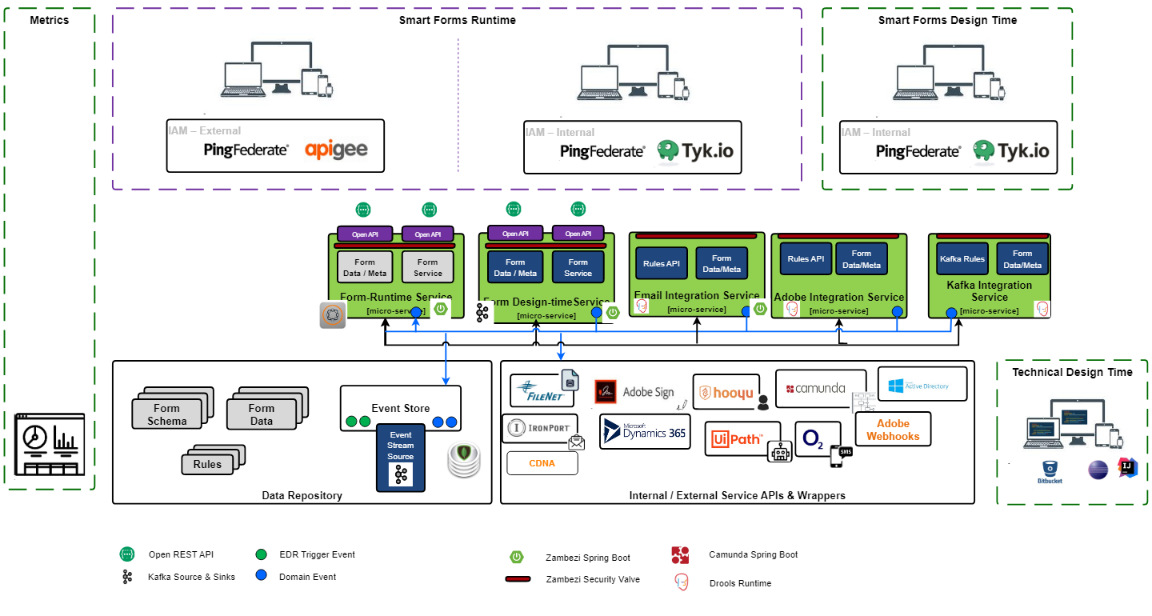



Design: EE eForms Platform Architecture (AS IS)
The details of each can be found in EE eForms platform design here
This is status of integration at the time of drafting this design
Available for prod use
In progress
Not available
21
21

Slide 22
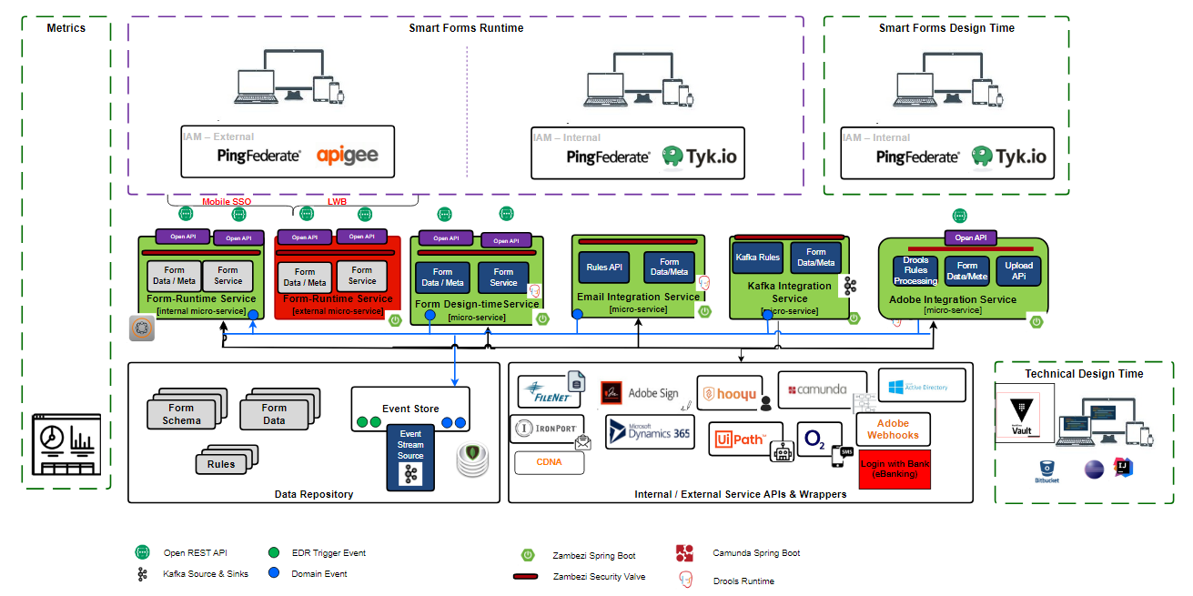






Design: EE eForms Platform Architecture (To Be)
The details of each can be found in EE eForms platform design here
This is status of integration at the time of drafting this design
Available for prod use
In progress
Not available
22
22

Slide 23


Design: High Level Solution Design – Internal Forms MVP
VCS/VCSe
VCS/VCSe
eForms Authors
Internal Users
RT SPA (Browser)
DT SPA (Browser)
HTTPS/REST
HTTPS/REST
TYK Gateway
Identity & Access Management (IAM)
RT API Proxy
DT API Proxy
Ping Federate
PCF Org - RETAILEFORMS
HTTPS/REST
HTTPS/REST
eForms Runtime SPA (Static Build Pack)
eForms Runtime MS (Java Build Pack)
eForms Designtime MS (Java Build Pack)
eForms Designtime SPA (Static Build Pack)
MongoDB-Java-Driver
HTTPS/REST
MongoDB-Java-Driver
D&A - MongoDB (Shared Cluster)
PCF Org - RETAILEFORMS
Email Integration MS
(Java Build Pack)
SMTP/ IronPort
Outlook
(mailboxes)
MongoDB Change
Streams
retaileforms_db
Ops staff
23
New
Existing - Changed
Existing – New deployment

Slide 24
Design: High Level Solution Design –External Forms MVP
Customer Device
Customer
(External User)
EXT RT SPA (Browser)
HTTPS/REST
F5
Apigee Gateway
NTMS changes
RT API Proxy
PCF Org - RETAILEFORMS
HTTPS/REST
eForms External Runtime SPA (Static Build Pack)
eForms External Runtime MS (Java Build Pack)
MongoDB-Java-Driver
D&A - MongoDB (Shared Cluster)
PCF Org - RETAILEFORMS
Email Integration MS
(Java Build Pack)
SMTP/ IronPort
Outlook
(mailboxes)
MongoDB Change
Streams
retaileforms_db
Ops staff
24
New
Existing - Changed
Existing – New deployment

Slide 25

Design: High Level Solution Design – Kafka Integration Services
EXT RT SPA
Customer
(Browser)
(External User)
Apigee Gateway
F5
RT API Proxy
NTMS Changes
HTTP/REST
PCF Org- RETAILEFORMS
Eforms Runtime MS
(Java Build Pack)
Eforms Kafka
Integration service
(Publisher)
Eforms Runtime SPA
(Static Build Pack)
MongoDB Java Driver
MongoDB Change Streams
Publish raw forms data on the form lifecycle topic through TCP TLS protocol
Mongo-Db Event Store
Kafka K4 AWS
Retaileforms_db
TLSTCTC
E-forms Form life cycle
Event Topic
(Kafka )
(All Form Data gets Stored in Event Store)
Downstream Consumer Applications
(Subscriber)
Existing
New

Slide 26
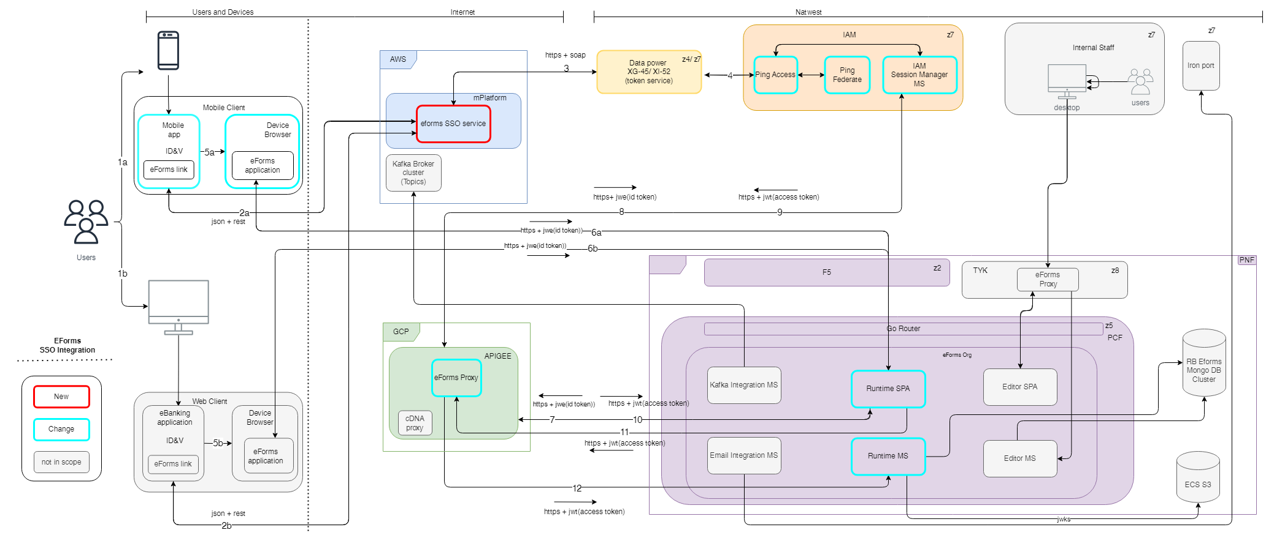
Design: High Level Solution Design – eForms SSO Integration

Slide 27
Design Description– eForms SSO Integration
1 | a.&b → User accessing either mobile app or ebanking to launch an eform via link for specific feature for example Credit card closure, Remove a party etc
2 | a &b → When a user selects eForms link within the Mobile App (or eBanking), the Mobile Client/eBanking SPA initiates a request to mPlatform eForms SSO micro-service(new) to generate an SSO Token. Dedicated eForms link would be placed and picked for redirection once JWE is returned from mplatform.
3 | mPlatform calls DataPower SSO Token Service where it creates a signed JWT using Data Power’s private key and pass through the request on to IAM PING Access, which then passes call on to IAM PING Federate. DataPower JWKS endpoint solution will be used to connect with IAM
4 | PING Federate validates the DataPower Signed JWT and generates its Signed JWT using the published Key (Supported via JWKS interface) and then encrypts the Signed JWT using the IAM Session Manager MS Public Key and returns the JWE via DataPower to mPlatform eForms SSO service.
5 | a&b →Mobile Client/eBanking SPA will then redirect to the eForms runtime SPA using the URL stored in reference data, appending the JWE as query string parameter (token) after mPlatform’s eForms SSO service passes the Encrypted (JWE) back to the Mobile Client/eBanking SPA.
6 | a&b → runtime SPA will extract the JWE and calls IAM Session Manager’s getToken API by passing JWE via APIGEE proxy.
7 | eFroms runtime SPA will call IAM Session Manager via Apigee exposed endpoints. The encrypted token is sent to IAM Session Manager for decryption.
8 | IAM Session Manager will decrypt the id token and extract the claims and attributes, then creates a separate JWT with all the original claims and attributes and get it signed from Ping Federate.
9 | IAM Session Manager send the access token to the eFroms runtime SPA. This token is only valid for 15 mins. A secure cookie is also sent along with access token. Cookie will reside in the application invoked browser with basic user details in it and used in every request that made to runtime service via apigee. The cookie will be lost when the browser session is closed.
10 | eFroms runtime SPA will get the access token and track the time they receive the token and renew the token using renew token API from IAM Session Manager before expiry to extend the validity for another 15 mins. Thus maintaining the customer verified session for maximum of 60 mins.
11 | Apigee proxy will validate and extract the claims and attributes then append in the necessary headers.(need to check how claims and values reaches runtime service)
12 | eForms runtime service will then extract the claims and attributes then expose the attributes for the runtime SPA to consume and show the necessary attributes in the appropriate form fields.

Slide 28
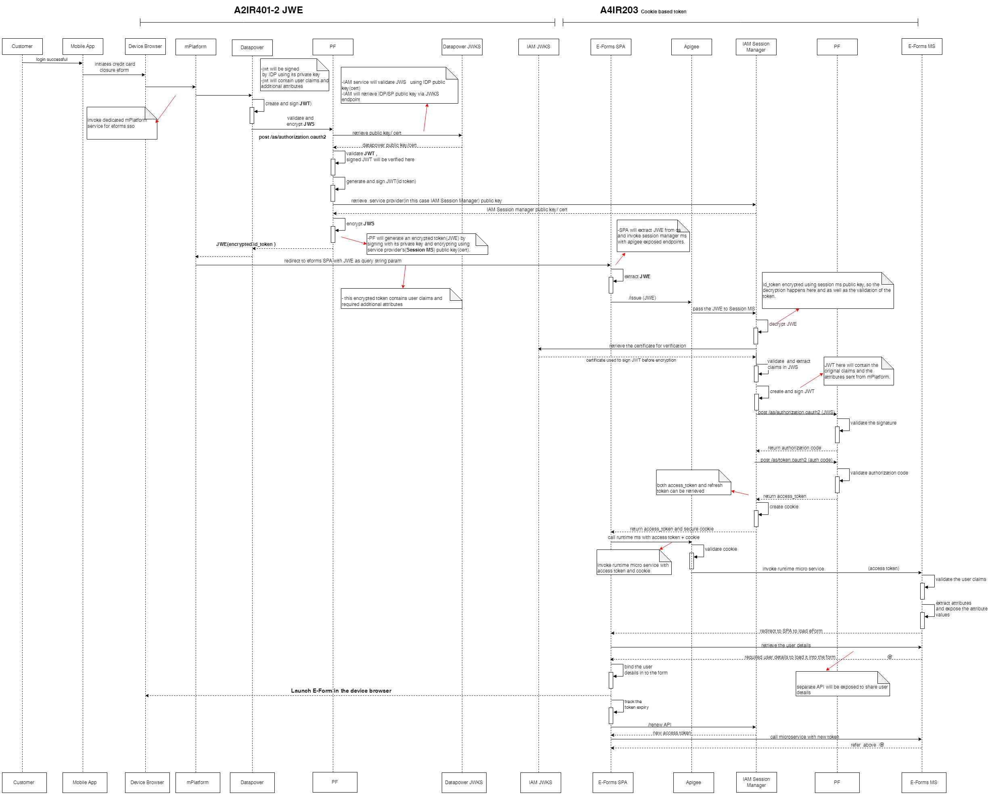
Sequence Diagram– eForms SSO Integration

Slide 29
Design: High Level Solution Design
Design Time SPA
Web SDK based SPA - SPA permits authorised users to design and administer eForm definitions.
Each eForm definition consists of a set of data schemas, UI schemas and rule sets that capture the expected form data structure, user interface widget mark-up and conditional logic.
Upon completion of an eForm definition, eForm authors can release their eForms generating release requests for review. Upon approval the eforms are released to production. The forms will be moved across environments by import/export functionality.
Design/Editor Microservice
This microservice API supports the Design Time UI SPA it provides the following functions:
Create, Read, Update, Deprecate and Release eForm definitions. Provides read access for historical revisions of eform definitions.
Implements the standard Mongo DB document revisioning model.
Run Time SPA
Web SDK based SPA - Using the data and UI schema instances for a given eForm definition this SPA generates the eForm to be rendered to the internal user and provides the runtime eForm execution environment.
The SPA based eForm runtime framework provides field level validation, conditional logic to show/hide field elements and form level validation to ensure data entered conforms to the eForm data schema.
Custom widgets are loaded dynamically allowing standard field types to be overridden to support more complex/controlled data entry.
Run Time Microservice
This microservice API supports the Run Time UI SPA it provides the following functions:
Create, Read, Update eForm instances. Provides read access for historical revisions of eform instances.
Implements the standard Mongo DB document revisioning model.
Validate state against the dynamic eForm meta model.
29

Slide 30
Design: High Level Solution Design
MongoDB Schema
Persists eform data schemas, ui schemas, ui rule definitions and instance data in JSON format. Using the standard Mongo DB revisioning pattern all data revisions are kept allowing detailed metrics to be extracted.
Mongo Event Streams allow integration services to synchronise activities and state with eform meta and instances.
Eform instance documents are structured according to the JSON data schemas defined by eform authors in the editor UI. This allows dynamic JSON path based queries to be built dynamically to support eForm specific MI reports.
Email Integration Services
These Integration services template/archetype uses MongoDB change stream event listeners (https://www.mongodb.com/developer/languages/java/java-change-streams/) to watch runtime forms data life cycle events from event-store. MongoDB change streams allow applications to access real-time data changes without the complexity and risk of tailing the oplog. Change streams use the aggregation framework, applications can also filter for specific changes.
Email Integration MS extends this integration services mechanism to react to eForm state transitions and send email to internal mailboxes through IronPort SMTP relay servers.
Kafka Integration Services
For a more robust pattern of event distribution from the event store, a Kafka integration service will be added. The intention being that this will reduce the number of direct connections and subscriptions to the event store collection in the eforms Mongo database thus reducing the load and resource burden of the mongo database. Instead a single Kafka Integration Service can be deployed for each environment (load balanced and fault tolerant across data centres) that will be the sole subscriber to the event store change stream, rather than maintaining a subscriber for each integration service, and will publish the events directly onto a Kafka topic and partition. The usage of Kafka gives us the following benefits:
Reduces the burden and resources on the eforms Mongo database
Greater flexibility for event distribution and with event topics
Consumer groups and partitioning to guarantee events are processed in the correct sequence
This is designed to the be the standard pattern for any down stream system, external to the eforms organisation to consume events from eforms. Downstream systems can consume events from a designated topic that eforms publish.
30

Slide 31
Design: High Level Solution Design
Security
The eForms used WIAM-02 security pattern to provide seamless user authentication for internal Staff users. The design uses PR006-IMP-02 where TYK will act as the Policy Enforcement point replacing PingAccess.
In the runtime context eForms will require authenticated tokens to be present in the HTTP request headers, these security tokens will be presented to IAM Ping Federate for validation. If the token is not authenticated, access will be blocked and the user notified.
In the design time context all access is secured. Users are assigned one of two SLX groups either EFORM-USER or EFORM-ADMIN. Fine grained permissions administered within the design time application by admin users permit users access to specific form definitions.
The microservices employ GEN02 ms2ms application security, NSX transport security and Routing Control Point infrastructure security.
31

Slide 32
Design: Key Functionality and Call Paths
What is the high level functionality for this Solution and the key building blocks to deliver it?
Should be precise in identifying a clear list of functions used in the solution along with a set of systems (along the call path) required to deliver each of these functions. A simple text form formula approach can be adopted to formalise and represent this in a table (example below) or replace with interaction diagrams or other diagrams where appropriate:
Functions | Formula
Create, Update and Query eForm Definition | EForm Design SPA (Corenet) ↔ TyK Gateway ↔ EForm Design MS ↔ Mongo DB (Corenet)
Load EForm (Internal) | EForm Runtime SPA (Corenet) ↔ TyK Gateway ↔ EForm Runtime MS ↔ Mongo DB (Corenet)
Submit EForm (Internal) | EForm Runtime SPA (Corenet) ↔ TyK Gateway ↔ EForm Runtime MS ↔ Mongo DB (Corenet)
Email eForms Data | Mongo DB (Corenet) ↔ (ChangeStream ) ↔ Email Integration Service ↔ EForm Runtime MS ↔ Mongo DB (Corenet) Email Integration Service ↔ IronPort /SMTP↔ Mailbox(Outlook)
Load EForm (External) | EForm Runtime SPA (Internet) ↔ F5 ↔ EForm Runtime MS ↔ Mongo DB (Corenet)
Submit EForm (External) | EForm Runtime SPA (Internet) ↔ Apigee Gateway ↔ EForm Runtime MS ↔ Mongo DB (Corenet)
Query EForm - Integration Service (Internal/External) | Integration Service ↔ TyK Gateway ↔ EForm Runtime MS ↔ Mongo DB (Corenet)
Update EForm - Integration Service (Internal/External) | Integration Service ↔ TyK Gateway ↔ EForm Runtime MS ↔ Mongo DB (Corenet)
(Kafka Retail eforms ) – on prem | Mongo DB (Core net) ↔ (Change Stream ) ↔ Kafka Integration services -> eforms Form Lifecycle topics <-> Consuming Application
External Runtime SPA | Mobile App/eBanking ↔ Device browser ↔ mPlatform ↔ F5 ↔ DP XG45 ↔ DP XI52 Device browser ↔ Eforms Runtime SPA ↔ APIGEE ↔ Eforms Runtime MS
32

Slide 33
Design: Supplementary Slides
Further slides should be added to ensure the design includes the necessary detail. These slides should describe the To Be diagram previously documented in this pack. The following should all be considered and included where necessary.
For multi-brand systems and where non ring-fenced bank users/systems are involved the requirements and component level design to maintain brand resilience, brand data separation, ring fence etc. should be described
Data migration requirements noting especially between geographically remote locations
Component models
Changes required at system level
State management design
Management Information design
More specific detail of the technology stack of the systems which are being changed through this Design (especially for new systems)
Details of any new technologies that are being adopted
Details of any new products, new frameworks (proprietary and open source) and any new development tools required (with justification).
Integration methods and protocol changes
A walkthrough of any architecturally significant use cases
Where necessary, additional slides may be added, but only architecturally significant features should be included within the body of the presentation. Less significant details may be included as appendix material when required.
Where architecturally significant components are being delivered, then these should by highlighted. (For example, components that are intended for reuse by other systems.)
Additional details available below, (Login with Bank a.k.a LWB is not in scope)

Slide 34
Design: High Level Data Design
Describe the Data Design for this Application
This design inherits the central eform data design patterns which is implementation of the Mongo DB standard versioning pattern.
Extensible and scalable document based storage mechanism for both eForm definitions (authoring) and associated eForm instances (runtime).
Meta driven eForm definitions that ensure completeness, accuracy and consistency of eForm instance data.
Versioning of eForm definitions and instances.
Auditing of incremental eForm state transitions in both eForm design and runtime.
Persistence of dynamic eForm meta/data models.
Validation of state against the dynamic eForm meta model.
Dynamic queries based on the eForm meta model.
Dynamic indexes based on the eForm meta model.
Dynamic event streams communicating eForm state transitions.
Key Form Definition Schema, Runtime Form Data, Rules and Event Store are key collections for the eForms schema.
The eforms will be capturing customer data in MongoDB. MongoDB is only a staging area and this data will be deleted as per retention requirements.
Data minimization principle will be followed while defining eForms templates.
34

Slide 35
Kafka Design: High Level Data Design
Describe the Kafka Data Design for this Application
This design inherits the central eform data design patterns which is implementation of the Mongo DB standard versioning pattern.
Submission of a new eform will place a new entry on the ongoDB event store.
The new submission will be picked up by the eforms Kafka Integration service and a new “lifecycle” event will be published.
This event payload will contain an eform submitted data with the reference number and type.
Using the Event Enrichment capability, the Kafka Integration Service will also obtain the form details required for the new business events, populate the full form payload and publish a new “business” event. No Retail specific transformation required – payload consists of raw form details.
Kafka will keep a register of which consumers have subscribed to which Topics.
Key Form Definition Schema, Runtime Form Data, Rules and Event Store are key collections for the eForms schema.
The eforms will be capturing customer data in MongoDB. MongoDB is only a staging area and this data will be deleted as per retention requirements.
Data minimization principle will be followed while defining eForms templates.
BCDM transformation
It has been agreed that no transformation would be required, form data will be passed straight through from raw form content data to form lifecycle event topic.
35

Slide 36
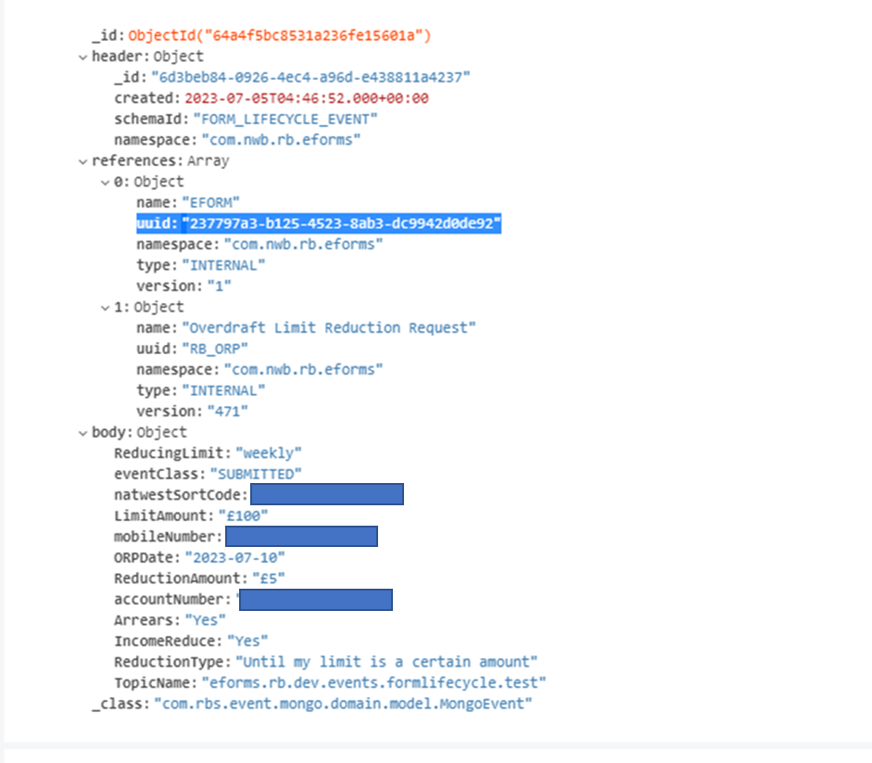
Kafka Design: High Level Data Design
Form data stored in eforms database
36

Slide 37
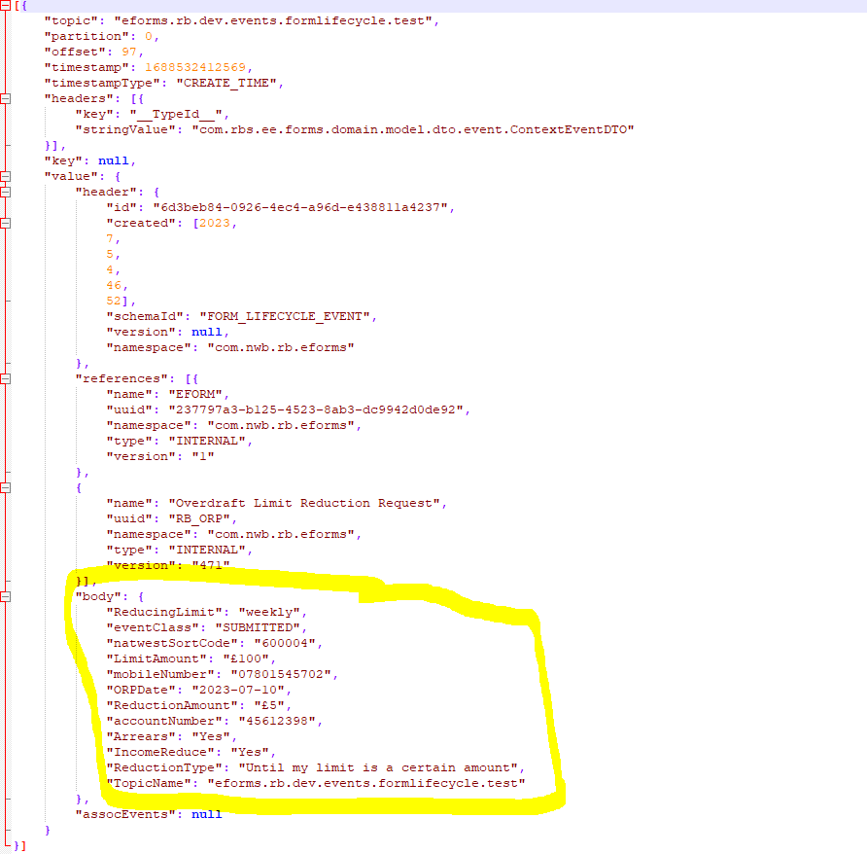
Kafka Design: High Level Data Design
Forms data published on kafka life cycle topic
37

Slide 38
Kafka Event Distribution- Sequence Diagram
Forms Runtime UI
Forms Runtime Service
Rules Engine
Event Store Collection(Mongo Db)
Kafka Integration Service
Form Life Cycle Topic
form submitted
Run Event Enrichment Rules
The event enrichment rules allow forms to be configured to add specific additional data(Domain Event Name) from either the form definition or the submitted form data to the published event body.
fields To Add To Event
Create Form lifecycle Submitted Event
form ID
change stream event subscription
Run Kafka Topic Partition Rules
Additional rules are available to determine which Kafka topic and partition to publish the event based on the contents of the received events. This includes any additional data added by the event enrichment rules.
Publish UUID & forms data on Form life cycle event
Topic Name and Partition Id

Slide 39
Design: High Level Data or Record Retention Design
Many applications maintain data stores that retain data, and any that do must include processing that periodically deletes any data that’s reached its retention period.
Applications that don’t retain data (i.e. whose data stores don't retain old copies of data or records) don’t need to have a data or record retention solution.
The Privacy Change Portfolio Programme (formerly the GDPR Programme) defined three types of data retention processes:
Housekeeping – Data that isn’t part of a business record must be deleted at the end of an agreed flat retention period. No deletion audits need to be kept.
Local Retention – Data that’s part of a business record, but which doesn’t need centralised Destruction Hold Order* (DHO) or End of Business Relationship* (EBR) checking must be deleted by the application at the end of a Record Retention Schedule (RRS)-defined retention period. A Business Record Manager Business Records Contacts will help decide what Record Class from the RRS the data belongs to – and that Record Class will define the retention period to be used. The design should consider how the application will cope with updates to the RRS, as retention periods do change occasionally. Local deletion audits must be kept.
Information Policy Management (IPM) Retention - Data that’s part of a business record and which needs centralised DHO or EBR checking should be deleted via IPM-managed retention processing. IPM complies with the Bank’s Managing Records policies and rules, and also performs fully defensible auditing of all record deletion, so exceptions to IPM use should be discussed with the IPM CoE Front Door Team.
The IPM CoE Front Door Team can provide assistance and contacts to help decide which retention process should apply for an application. Details can be found here: Information Policy Management.
* DHO – Destruction Hold Orders are lists of customers or accounts whose records must not be deleted because of ongoing complaints or investigations. Application designs that need DHO processing will be advised of how the DHO data should be retrieved. It's not possible to know whether data that isn't currently the subject of a DHO will need centralised DHO processing in future, so the DHO aspect of choosing Local Retention or IPM Retention will rely on the Business Record Manager or data owner's best guess of future DHO requirements.
* EBR – Some business records cannot be deleted until the customer to whom those records relate has reached the end of their business relationship with the Bank, i.e. has no further contractual products or relationships with the Bank. Individual Applications are usually unable to determine this from data they hold. The IPM deletion control process has an EBR validation capability which can ensure records for a customer with multiple products or activities are retained until the retention period following the end of their business relationship with the Bank has expired.
39

Slide 40
Design: Infrastructure Design – As Is
Describe the current Infrastructure Design
What is the As Is infrastructure Design?
Include a Diagram showing the current infrastructure components and their interactions.
What instrumentation (Monitoring, Alerting) is currently used ?
May not be required if the design is new or not substantially changes and the following slide shows changed and new components.

Slide 41
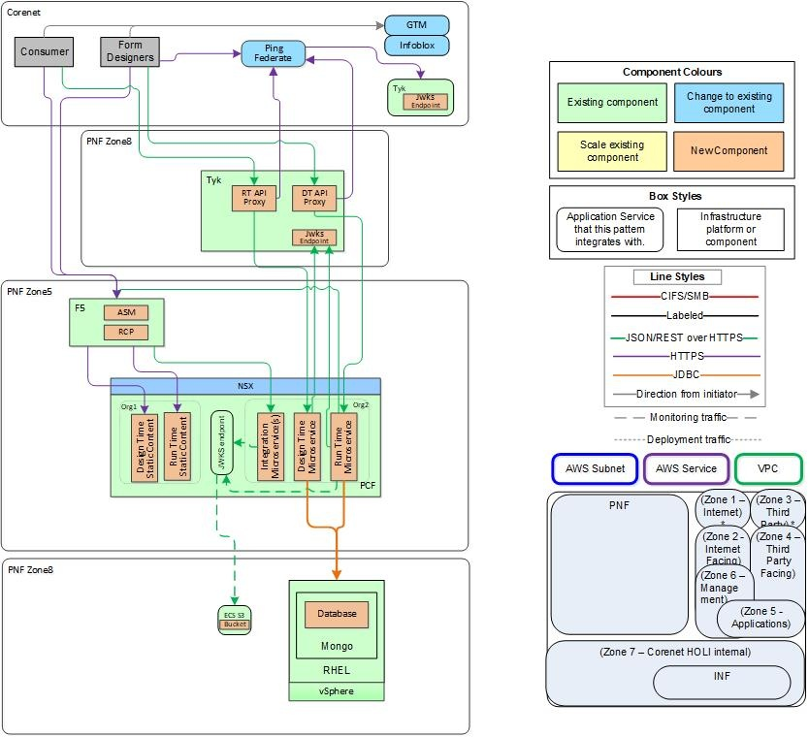

Design: Infrastructure Design – To Be (Internal Forms)
SMTP over TLS
Corenet
PNF Zone8
Ops Users
IronPort
(Cisco ESA)
VCS
MS Outlook
SMTP
SMTP
MS Exchange
41

Slide 42
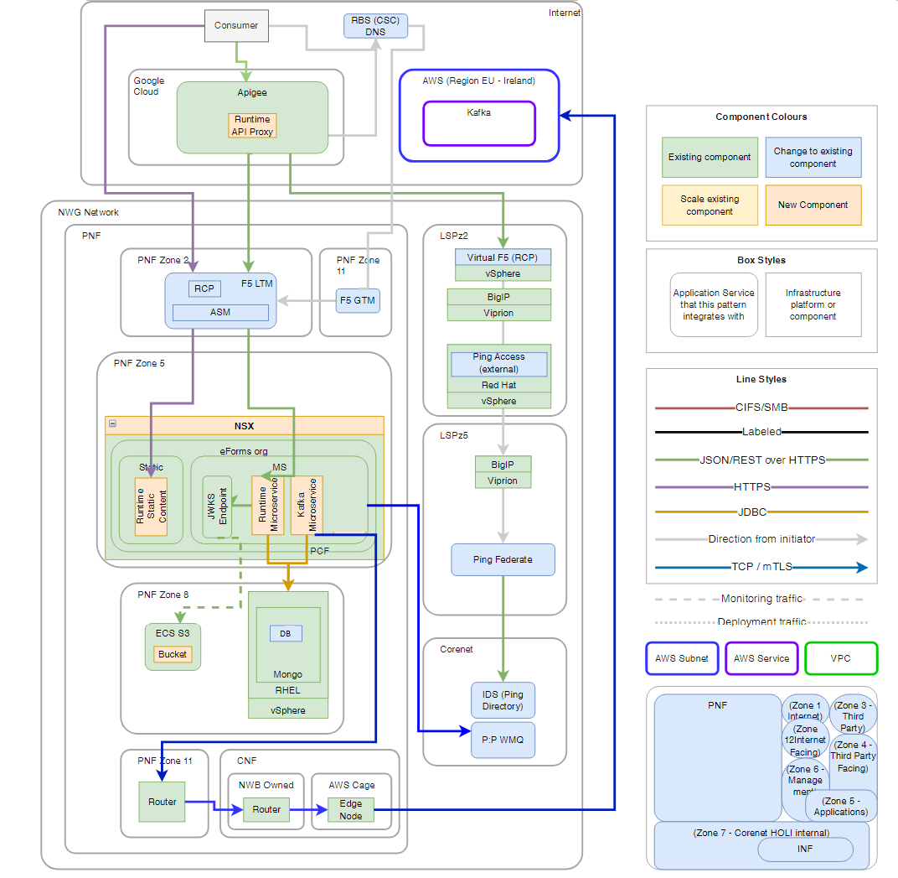
Design: Infrastructure Design – (External Forms)

Slide 43
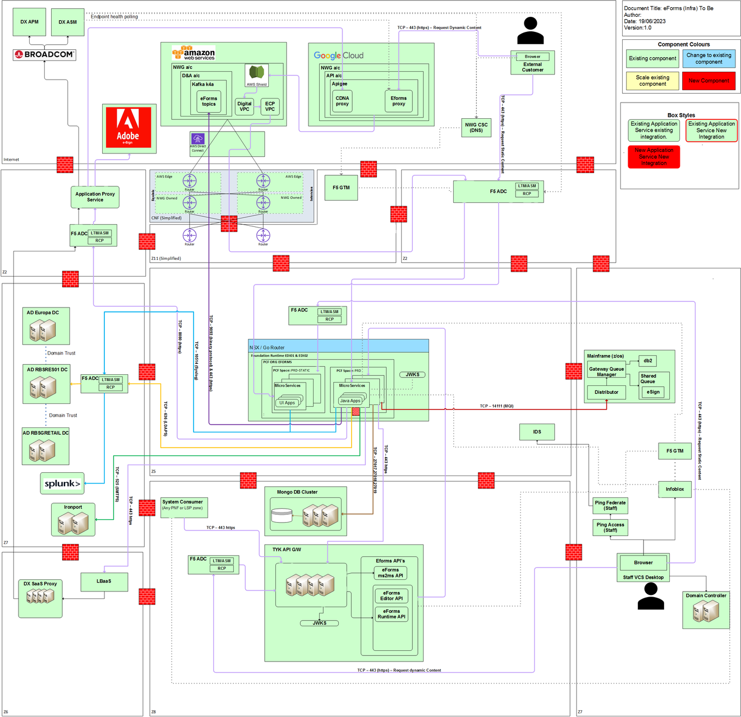
Design: Infrastructure Design(As - Is) – eForms

Slide 44
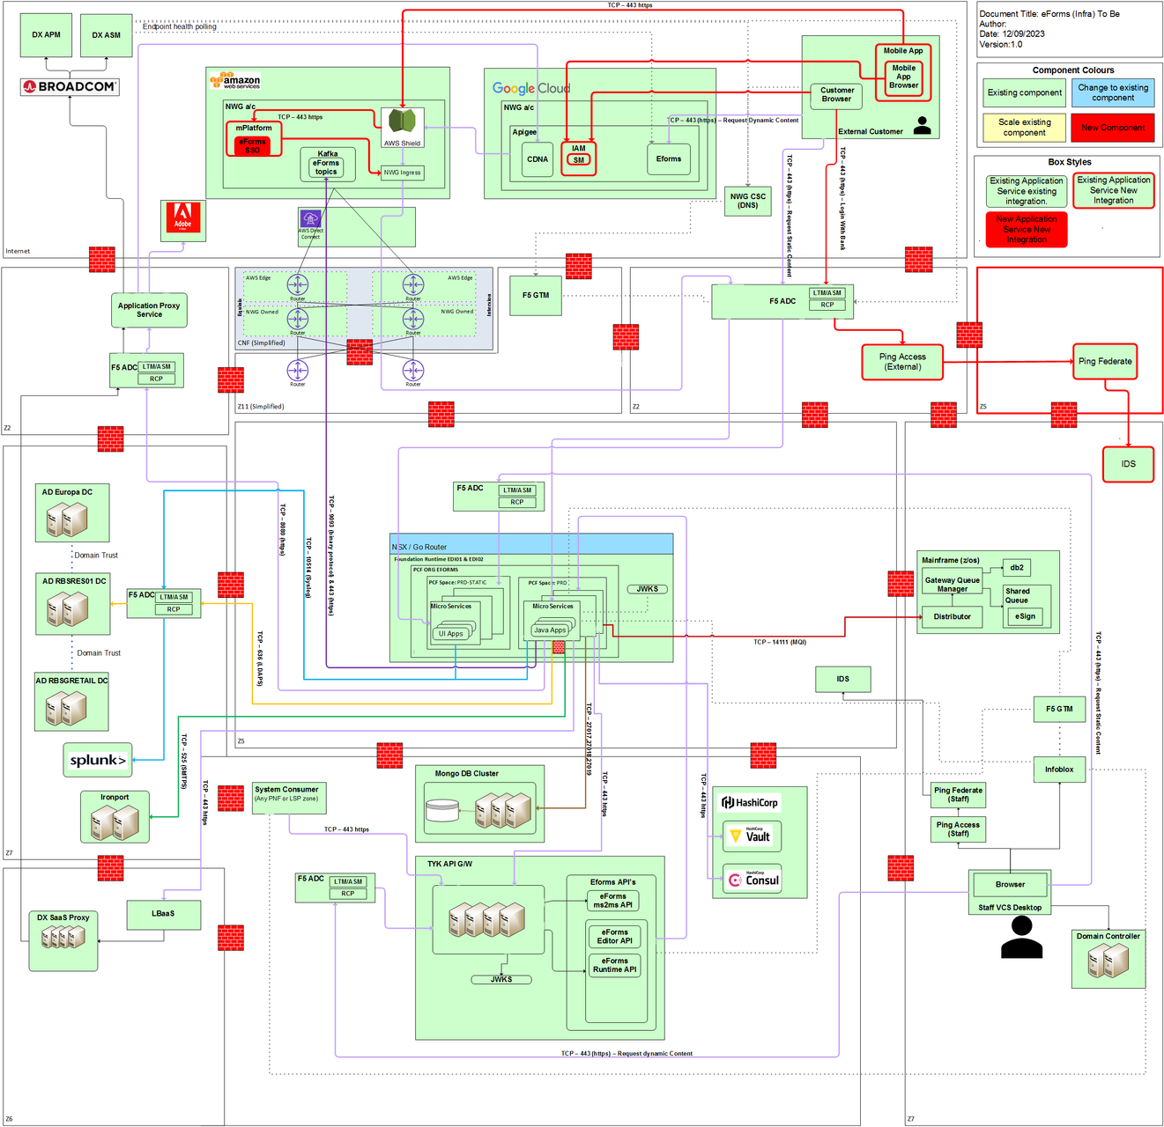
Design: Infrastructure Design(To-Be) – eForms

Slide 45
Service/Infrastructure Summary
Where appropriate provide the Product/Pattern reference code. Describe requirements and changes for each service, deployment pattern and infrastructure product. Numbers of servers and/or locations/environments should be included where appropriate. For each also make it clear whether there is any adoption engineering requirement and whether this is under Prodcat or ETF. State the team that supports the component.
Service, Pattern or Product Reference | Summary of requirement / change | Standard usage or adoption requirement | Agreed support team | Associated Security Standard
WIAM-02 - "Simple SPA" - WIAM authorisation model / IDS groups | Internal Design Time SPA course grained access control. | Standard Usage | Enterprise Engineering | N/A
SP001 (PR001-ICP-01) - Internal Facing Unsecured Static Content | Run-time / Design-time SPAs loaded from static micro-services in PNF/PCF. | Standard Usage | Enterprise Engineering | SAS_004
SP006 (PR006 -IMP -04) - Internal facing API service | Run-time / Design-time micro-services hosting eForm instances and eForm definitions. | Standard Usage | Enterprise Engineering | SCP_003
PR010-MMWA-01 - MS2MS cross-site within App for PNF PAS F5 RCP | Integration micro-services interacting with eForms Runtime SPA. | Standard Usage | Enterprise Engineering | SCP_002
SP002 (PR002-SCP-01) | External SPA static content in PNF | Standard Usage | Enterprise Engineering | SCP_001
SP007 (PR007-SMP-01) | External API MSs for PNF PAS (LSP PingFed) | Standard Usage | Enterprise Engineering | SCP_005
Not Applicable | SCP_039 - FDN - Secure Message Queue (MQ) | Standard Usage | Enterprise Engineering | SCP_039
A2IR401-02 - Issue Identity Token through JWT Authentication Policy (A5IC210) - Solution Patterns - Confluence (atlassian.net) | Mobile SSO Integration to eForms runtime SPA | Standard Usage | Enterprise Engineering | SCP_009 - FDN - Secure Identity & Access Service
A4IR203 - Adoption Process for Session Management | eForms runtime SPA to runtime ms for managing user authenticated session | Standard Usage | Enterprise Engineering | SCP_009 - FDN - Secure Identity & Access Service
Describe Application Operational Management Design
Application component(s) | Monitoring, alerting, logging & heart-beating design and products
Run-time / Design-time/Integration micro-services | PaaS Introscope, PaaS Application Logging, Heart-beating - Spring Boot Actuator
MongoDB | Alerting in MongoDB - MongoDB Engineering - Confluence (rbsgrp.net)
Kafka Microservice | PaaS Introscope, PaaS Application Logging, Heart-beating - Spring Boot Actuator
45

Slide 46
Security Design including deviations from Security standards and patterns
User authentication and authorisation (Internal Customers) | WIAM02 leveraged to provide secure access to the internal design and runtime SPAs. Simple course grained roles are stored centrally via IAM.
Roles and permissions | EForm 'User' and 'Admin User' roles are defined as 'system level' roles and managed centrally via SLX. Further 'application level' roles can be administered by admin users within an eforms application.
Payment Security | N/A
Impact of PCI | N/A. No full PAN or any other PCI data will be processed or stored by the application.

Slide 47
Security Design including deviations from Security standards and patterns
Pattern/Standard Reference | Pattern/Standard Name | Security Controls
PR010-MMWA-01 | MS2MS cross-site within App for PNF PAS F5 RCP | PR010-MMWA-01 - MS2MS cross-site within App for PNF PAS F5 RCP#MMWA-01-MS2MScross-sitewithinAppforPNFPASF5RCP-SecurityControls
SP001 (PR001-ICP-01) | Internal Facing Unsecured Static Content | SCP_004 - UCS - Internal Consumer Browser Access to Static Bank Content (Anonymous)
SP006 (PR006 -IMP -04) | Internal facing API service | SCP_003 - UCS - Internal Consumer to DMZ Hosted Workflow Dynamic Content
SP002 (PR002-SCP-01) | External SPA static content in PNF | SCP_001 - UCS - External Consumer Browser Access to Static Bank Content (Anonymous) - Security Architecture Services - Confluence (rbsgrp.net)
SP007 (PR007-SMP-01) | External API MSs for PNF PAS (LSP PingFed) | SCP_005 - UCS - External Consumer, Via SaaS API Gateway, to DMZ Hosted Workflow Dynamic Content - Security Architecture Services - Confluence (rbsgrp.net)
DSP1b | Input Streaming Pattern | Certificates to be added for consumer-broker mutual authentication and data encryption. AD Groups for authorization of service user
Kafka Product Page | Microservices consuming data from Kafka Topic | AD Groups, Service accounts and mTLS
A2IR401-02 - Issue Identity Token through JWT Authentication Policy (A5IC210) - Solution Patterns - Confluence (atlassian.net) | Issue Identity Token | SCP_009 - FDN - Secure Identity & Access Service
A4IR203 - Adoption Process for Session Management | User Session Management | SCP_009 - FDN - Secure Identity & Access Service

Slide 48
Resilience Design including deviations from standards and patterns
IT Resilience policy compliance is a mandatory requirement for all new and changing Service Elements Contact: ~ Resilience & Continuity, Resource & Demand for support.
Within this section, document the keys aspects of the Resilient and Recoverable design highlighting elements which deviate from, or do not follow approved the resilience and recovery approach defined in the standards and patterns.
Describe resilience and continuity design approach for:​
The capability to maintain IT Application availability and or recover from the loss of a Data Centre, Cloud Hosting Location (region), Infrastructure, Network, Data or Corruption, or an IT Application.​
Resilient and fault tolerant IT Applications, including the capability to operate from a single site without single points of failure.​
Capability to recover from both replicated AND backup data stores reflecting the business requirements, including recovery point objectives.​
Meeting the resilience and recovery requirements of Inter-IT Application dependencies.​
Monitoring and alerting capability to detect adverse events before they impact customers.
Capacity and performance management to ensure they meet the immediate and on-going needs of the business service.
Resilience and continuity proving capability to allow for implementation and subsequent periodic testing.

Slide 49
Connections: Protocols, Security & Resilience
Where connections pass through load balancers or firewalls without terminating then these are not to be regarded as components and should be added as a note in the Receiving Component. The protocol for the connection, such as MQ, HTTPS and whether privacy is provided by TLS, for example, should be provided. The receiving node should normally authenticate and authorise the requesting node’s identity; the mechanism for this should be stated. Connection Resilience should describe load balancing and fault tolerance responsibilities, method of identifying target endpoints, endpoint health and retries etc.
Component establishing connection | Component receiving connection | Connection Protocol and Privacy | Connection Authentication and Authorisation | Connection Resilience
EForm Design SPA | EForm Design Microservice | HTTPS, TLS 1.2 | OAUTH - Staff IAM | PR007-SMP-01, PR006-IMP-03
EForm Runtime SPA | EForm Runtime Microservice | HTTPS, TLS 1.2 | OAUTH - Staff IAM | PR007-SMP-01, PR006-IMP-03
Design Microservice | Mongo DB | TCP/IP, TLS 1.2 | Service Account encrypted service name/password
Runtime Microservice | Mongo DB | TCP/IP, TLS 1.2 | Service Account encrypted service name/password
Mongo DB | Integration Microservice | TCP/IP, TLS 1.2 | Service Account encrypted service name/password
Integration Microservice | EForm Runtime Microservice | HTTPS, TLS 1.2 | OAUTH - Service Account | SP010 - PaaS MS2MS call within application
Integration Microservice | IronPort Gateway | SMTP, TLS1.2 | Service Account encrypted service name/password
Consumers/Producers | Kafka Brokers | TCP, TLS | mTLS
Mobile/ebanking App | Eforms Runtime SPA | HTTPS, TLSv1.2 | Oauth | A2IR401-02 - Issue Identity Token through JWT Authentication Policy (A5IC210) - Solution Patterns - Confluence (atlassian.net)

Slide 50
Solution Resilience Design
For each solution component refer to the specific standard pattern or describe the operational resilience (infrastructure component fault-tolerance) and Data centre failure resilience design. If there is a Response resilience requirement then this should also be described.
Solution component | Operational Resilience | Data Centre Resilience | Response Resilience (if required)
Runtime Service - API | PR007-SMP-01, PR006-IMP-03 | PR007-SMP-01, PR006-IMP-03 | N/A
Runtime Service - Static | PR002-SCP-01, PR001-ICP-01 | PR002-SCP-01, PR001-ICP-01 | N/A
Design Service - API | PR006-IMP-03 | PR006-IMP-04 | N/A
Design Service - Static | PR001-ICP-01 | PR001-ICP-01 | N/A
Integration Service -API | PR006-IMP-03, SP010 - PaaS MS2MS call within application | PR006-IMP-03, SP010 - PaaS MS2MS call within application | N/A
MongoDB Shared Cluster | MongoDB share clustered having 3 nodes across 2 data centers including DR enabled node. | MongoDB share clustered having 3 nodes across 2 data centers including DR enabled node. | NA
Kafka Native | Native resiliency offered by the product | Cluster is stretched across 3 AZs. Failure in one AZ is tolerated by the Kafka Cluster implicitly (provided min.isr < 3) | NA
eForms SSO Integration | A2IR401-02 - Issue Identity Token through JWT Authentication Policy (A5IC210) - Solution Patterns - Confluence (atlassian.net) IR203-02-AuthN-Web API Security Session Management | SCP_009 - FDN - Secure Identity & Access Service | N/A

Slide 51
Solution Resilience Design
Data
Describe for each data store in the design how that data is stored and replicated for resilience and how the data is backed up and capable of being restored to meet the required RTO and RPO. It is acceptable (and preferred) to refer to specific standard platform backup and recovery standards. Any specific non-standard requirements should be explained.
Data Store | Data Storage/Replication | Backup/restore
D&A Mongo DB | Data will be automatically backed up in continuous manner by MongoDB Ops Manager. MongoDB shared cluster backup snapshot will be configured using default configuration. | Data will be restored from backed up files using MongoDB Ops Manager as per Tenant request.
Kafka | Cross site replication provided implicitly according the topic configuration and the kafka zone awareness during the replication | Kafka maintains replicas across 3 AZs synchronously

Slide 52
Capacity, Volumes & Performance
Where capacity requirements or volumes are significant, for example in registered users, transaction rates or database/file volumes for certain components of the system then this slide should be included and details completed in the table below.
Application Component / Infrastructure Component | Measurable Business or Technical Volumetric (trans/sec, GB etc) | Current volumes | Day 1 requirement | 12 month requirement | 3 year requirement
MongoDB | GB |  | 100 GB | 100GB | 300 GB
eForms submissions | Volume/year | 12 million/year | Tbc* | 2 million/year | 12 million/year
eForms Template | NA | ~ 5000 ** | Tbc* | ~ 300 | ~ 5000
Credit Card Close via mobile | Volume / month | 6.5k/month | ~250 | ~80k/year | ~240k
Credit Card Close via web chat & telephony | Volume / month | 3.5k/month | ~115 | ~42k/year | ~130k
* Migration plan and prioritize list of web forms to be migrated on Day 1 is currently being worked upon.
** Initial estimates from business for web forms templates used across Retail Banking.
52

Slide 53
Delivery Scope: Technology Controls Requirement
Applicable for all systems deployments including internal and public cloud hosted
For further information on Technology Controls (Application, Infrastructure & Public Cloud):
Technology Controls must be considered to understand the end to end risks as per EWRMF and Change Risk assessments.
For services deployed in the public cloud, the inherent risk of the service - per the Operational Risk Impact Classification Matrix - should be determined. The key cloud IT controls are then assessed to arrive at the residual risk position. Any open control gaps are fed into your programme Change Impact Assessment / Change Risk Review, as well as the Workload Placement Authority (WPA). The cloud IT risk and control pages provide an overview of the Cloud IT Risk and Controls Assessment process that must be followed for public cloud deployments.
Contact: ~Services Controls Cloud CoE for queries about technology controls for public cloud hosted deployments. Contact: ~ Application Testing - Managers for queries about application controls support for internally hosted deployments
Technology Controls guidance
Key Application, Infrastructure and Cloud IT Controls
EWRMF Key Control Guidance
Cloud IT Controls (applicable to public cloud deployments only)
Technology Controls Initial Questions | Rating/ Details
IT Inherent Risk for Information Loss & Integrity per Impact Classification Matrix ICM (Major/ Significant/ Important/ Minor) | (Major/ Significant/ Important/ Minor)
2. IT Inherent Risk for Technology Disruption per ICM (Major/ Significant/ Important or Minor) | (Major/ Significant/ Important/ Minor)
Does this Technology Solution involve third party outsourcing that meets the criteria for critical or important (material) outsource per SCS guidance here? | Yes (CIOM) / No (not CIOM) / enter n/a if no 3rd party outsourcing
Summary of workload placement to be hosted on public cloud. I.e. what aspect of the technology solution is to be hosted (SaaS/ PaaS/ IaaS/ Hybrid) | Provide a brief description which aspects of the service is hosted in the public cloud. (enter n/a if there is no hosting in the public cloud)

Slide 54
Design: Design Assurance
Workload Placement Assessment https://intranet.rbsres01.net/Businesses/Services/Technology/Pages/Cloud-Workload-Placement.aspx
The Workload Placement Decision Tree (WPDT) must be used to determine the most appropriate hosting location for the service. If the result of that WDPT analysis is that the service will be hosted internally (e.g. on-premise Private Cloud or other internal environment such as Virtual / Physical Servers or our Mainframe) then there is no requirement to complete an associated Workload Placement Assessment form, please simply detail the results of the WDPT analysis in the table below. If there is any external Cloud element to the service, then a Workload Placement Assessment form must be completed and appropriate details captured in the table below.
Key Question : Has a Workload Placement Assessment been approved (if required)? Yes / No / Not Applicable*
Technology Governance Framework
The Domain-aligned Architect or Engineer MUST follow the CTORB Scorecard in the Appendix at least once for this design at design completion (a final scoring is part of the audit trail) , but scoring can be performed iteratively during design or whenever design issues arise. Please record use of the Scorecard in the table below , ensuring that at least one scoring is performed at design completion. Additional rows (with dates) can be inserted. Any single No answer from the Scorecard means the overall response to the framework compliance Key Question must be No. A “No” response to the Key Question means that a Referral to Governance must be made. See ‘Making a Referral’.
Key Question : Does this design comply with the Technology Governance Framework? Yes
Making a Referral
A No answer to either of the above Key Questions means the Design MUST be reviewed and approved at the CTO Review Board (CTORB) . Please follow the process for an identified non-compliance Infrastructure Design Governance Referral - Hosting Solutions - Confluence (rbsgrp.net) . Referrals and their outcomes MUST be recorded in the Design Review section of the HLSD Governance History as part of the audit trail.
Design Assurance Conclusion
* If after iterative design any of the Key Question answers remains as No, the design is not within CTO Governance.
WPDT Analysis Outcome | WPDT reference number | Approved at CTO RB | Approved at WPA
Provide a brief summary of outcome. Note: If deployment is internal only, then all other fields in the table are “Not Applicable” | Not Applicable (Existing Kafka Cluster on AWS (K4) will be leveraged) | Not Applicable (Existing Kafka Cluster on AWS (K4) will be leveraged) | Not Applicable (Existing Kafka Cluster on AWS (K4) will be leveraged)
Date of CTORB Scoring | Aligned with Workload Placement Strategy ? | Uses a known/good Infrastructure configuration ? | Uses existing/supported Infrastructure products ?
Leveraging existing & Proven eForms platform provided by Enterprise Engineering | Yes | Yes | Yes

Slide 55
Design: Decommissioning Design incl for Pilot or PoC Designs
This is not PoC or Pilot. However, delivery of this platform will enable decommissioning of legacy web forms platform like OLAF, WAIF, ELA forms etc. one migration is complete through multiple phases of project delivery.
55

Slide 56
Design Inputs: Design Decisions Made
Describe any key design decisions made for this Solution
No
No | Decision | Rationale | Alternatives
1 | eFroms as Web Forms creation services | The Internally built eForms platform will provide cost, UI customization and integration benefits over other alternative considered. https://confluence.dts.fm.rbsgrp.net/display/EFORMS/28+-+Design+Inputs%3A+Design+Decisions+Made | Option a. Fujitsu's Kitachi solution - Not recommended as it was not holistic enough Option b. Adobe forms -Not recommended as it was very costly for the volumes considered for the implementation Option c. Microsoft forms - Not recommended as it was not holistic enough
2 | Dedicated Retail Banking eforms Infrastructure | The dedicated retail infrastructure ( i.e. PCF Org and MongoDB Schema) was recommended for required autonomy, flexibility and capacity requirements in line with other franchises. | Option a - Retail Using SS Infra - Not recommended due to capacity constraints, dependency, retail specific integration requirements and keeping SS instance open for other franchise use cases. Option b - Retail and SS sharing PCF Org – Not recommended due to low benefits cost/timeline against the complexity/dependency.
3 | Kafka Integration Services | The Current customer forms data will be passed to downstream applications via email integration service which is non strategic integration approach as there are many risks associated with data sending via email (Like data loss, data privacy etc.) | eForms platform already provides Kafka integration capability. Retail will leverage this Kafka integration for integration of eforms with down streams. Current consumer pattern only recommend lifecycle event without data followed by API call for fetching form data. This pattern is not suitable doesn’t align to EDA hence Retail will publish form data as part of event payload without any transformation in the raw form data. Kafka integration will be a default consumer pattern of all the new Business events.
56

Slide 57
Design Inputs: Design Decisions Made
Describe any key design decisions made for this Solution
No
No | Decision | Rationale | Alternatives
1 | Customer Authentication Routes Undifferentiated network routes: (URLS will not differ for secured and unsecured, it will be same) | Recommend Option A(undifferentiated routes ): The advantage of maintaining undifferentiated routes is simpler set of network deployment actions per form and form type. Any given eForm is deployed to a single url (per brand/franchise/lob), and the conditional logic and configuration for authentication is made by the eForms back end code and configuration data. This implies a potentially smaller application footprint (see note) and simpler deployment and ops support processes. | Under Customer Authentication routes decision , there were two options .Both Option A and Option B is explained in the attached pdf document. (Please refer only the “Decision Template : Customer Authentication Routes”)
2
3
57

Slide 58
Design Inputs: Roadmaps and Strategic Direction
This slide should demonstrate how the solution aligns with the Bank’s strategic SOA direction and explain any deviations from this strategy.
The eForm core platform will be run as an open-source project within EE. Cross franchise cross brand deployments & upgrades will be supported by the core platform teams.
Franchise environments will be managed and supported within each franchise. Retail Banking instance eFroms(Retail) will be managed and supported with Intelligent Automation platform in SEDT domain.
The eFroms platform will be contributing to RB Digitech/SEDT OKR for End-to-end Digital Customer Journeys and decommission legacy forms platform.
What patterns (architectural, integration patterns) is solution using?
EForms leverages the WebSDK and contributes standard widgets and component
Does your solution deviate from roadmaps?
None
58

Slide 59
Design Inputs: Assumptions & Constraints
Please ensure that any assumptions are recorded in Planview where appropriate
What are the Technology Constraints that have impacted the Design?
The eForms does not have feature or component to delete form data from MongoDB. This feature will be developed by EE eFoms platform in future release. The deletion of data from MongoDB will be done through MongoDB support team under a change process till feature is in place.
Out of Box Integration services by eFroms, currently uses mongo change stream event listeners to react to eForm state transitions, Kafka events are being considered for such use cases in future.
What are the other non-Technology Constraints that have impacted the Design?
There is dependency on central/EE eFroms platform to deliver functional or technical features required for retail requirements.
What Assumptions have underpinned your design?
During migration of exiting forms to eForms, automated end-to-end journey will be considered over like-to-like migration.
Tech Support is currently constrained to UK office hours for Intelligent Automation and Tyk team. This will be enhanced to 24x7 in future.
59

Slide 60
Open Design Issues and Risks
Please ensure that any Issues and Risks are recorded in Planview and/or Vantage where appropriate
Design Challenges:
The Eform architecture is not truly multi-tenant and hence franchise specific environments are being stood up.
The eForms platform by design is brand specific i.e. one eForms instance and brand specific URL will be provided. It is challenge to create multi-brand/un-branded eForms. This is being looked by EE to create NWG group level brand.
There is currently no retry mechanism for re-try events that were out of box integration services failed to process. There is risk that some of the events may not processed as desired e.g. will not be delivered. Some automatic retry and manual solution needs to be in place. The EE platform team will consider building this functionality or provide alternate integration mechanism.
Design Risks:
Reference | Risk Description | Owner | Mitigation
Captured as Risk# 20 in eforms RAID log - E_Forms_RAID_V1.2.xlsx | There a risk of unwanted submission of forms by human/bot due to unauthenticated eforms and this will create junk request and overhead for Business to manage this. Currently Infra/Security controls are in place to avoid spamming due to high volumes of request (DOS) however low volume requests from bot/human could go through. | Conor Patterson, Andrew A Murphy | PBBA Dispute Background Business Process in BPM will have controls to stop such bad requests i.e. invalid Account number / sort codes. BPM wont be able to locate the account, so a case will never be created.
60

Slide 61
Appendix: HLSD Quality Criteria
Are all high-level requirements addressed?
Does the solution take into account the appropriate regulatory requirements, e.g. the Conduct Risk policy, Treating Customers Fairly (TCF)? All policies can be found here.
Is the solution consistent with the original solution as defined in the Define stage activities?
Is the purpose of the design in terms of the business processes it supports clear?
Is the scope of the design clear?
Does the design comply with Operational Readiness requirements and relevant Technology architectures and standards including the design and data design principles?
Does the solution meet the requirements detailed in the Operational Resilience IT Resilience Supporting Guidance?
Does the solution comply with the Group Information Security Policy requirements?
Does the solution comply with the Group Records Management Policy requirements, if it retains records?
Does the solution design adhere to the appropriate Technology and local architectures and technical standards?
Does the solution provide a sound foundation for the detailed design of applications, infrastructure and subsequent components?
Does the solution support the needs of those who will support and maintain the delivered application?
Does the solution cover all the required application software on all platforms to deliver the required functionality?
Are infrastructure components to provide services such as printing, audit, access control, batch scheduling, records retention, etc. identified?
Has the solution taken into account whether the Platform or any of the base services operate and support MASI (Mainframe Application Stand-in) ? Examples ATM’s including AT/Connex, eBANKING (Account Summary), NAP, Customer DB, ACES and OAKM.
Are interconnections and interactions between components identified?
Have re-use and purchase options been fully explored for all custom-built components?
Does the solution comply with General Data Protection Regulation(GDPR) , if it contains personally identifiable information (PII)?

Slide 62
Appendix: CTORB Scorecard
Does your Solution Design …
1) Align with Technology’s Workload Placement strategy?
You can answer "Yes" to this question if the hosting environment for your solution is in line with the Workload Placement Decision Tree (WPDT), e.g. you are using …
an existing strategic solution to meet the requirement,
our on-premise Enterprise Cloud Platform (ECP) environment,
an external cloud solution that has been reviewed / signed by the Workload Placement Authority.
You must answer “No” to this question if your hosting environment is not aligned with the WPDT, e.g. an existing strategic service could have been used to meet your requirements but a decision has been taken to deploy a new service thus potentially increasing complexity / cost in our technology estate (i.e. having 2 services when 1 would do).
2) Use a known / good infrastructure configuration?
You can answer "Yes" to this question if your design is using …
approved / published Realisation Pattern(s) without any variations
a proven / accepted configuration that has been used in designs previously (without any additional infrastructure governance review)
You must answer “No” to this question if your design is using …
a variation on an approved / published Realisation Pattern(s)
an unproven configuration, e.g. new products being used or existing products being used but in a different way
a configuration that has only ever been deployed previously by exception / on a tactical basis, i.e. known to require infrastructure governance review on a case-by-case basis.
3) Use existing / supported infrastructure products?
See the Infrastructure Portal for a list of available products. If the products you are using are listed in the portal then you can answer “Yes” to this question.
If you are using any products that are not listed in the portal, e.g. the product may be classified as legacy / exit, or the product is currently being adopted, then you must answer "No" to this question.
Additional guidance on determining the correct answers to the above questions can be viewed on this FAQs page.
Any single “No” answer to the above questions means that this Solution Design must be referred to the CTO Review Board because there is an issue that requires its Review and Approval. See Infrastructure Design Assurance and Governance Referral pages for more information.

Slide 63
Appendix: Principles and Guidance for Good Designs
Follow below reference principles and guidance for designers/architects to prepare a good design:
One Bank Principles - One Bank Principles
Technology Principles - Technology Principles

